Slide 1

Tainan city
Member：Cheng-Han-Wu (吳承翰)
Chun-Ju-Hsieh (謝鈞儒)
Bill-Chen (陳柏元)
Ciou-Miao-Guo (郭秋妙)

Slide 2

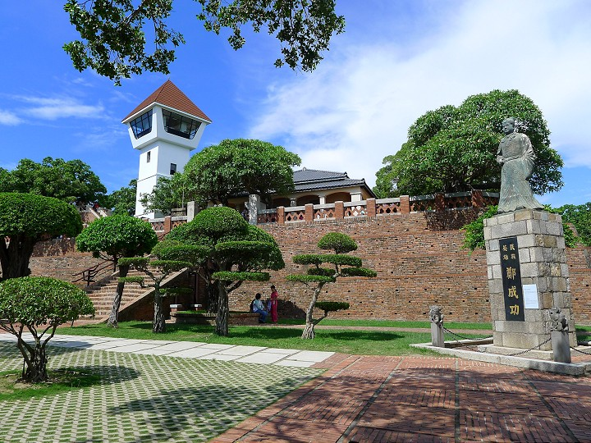
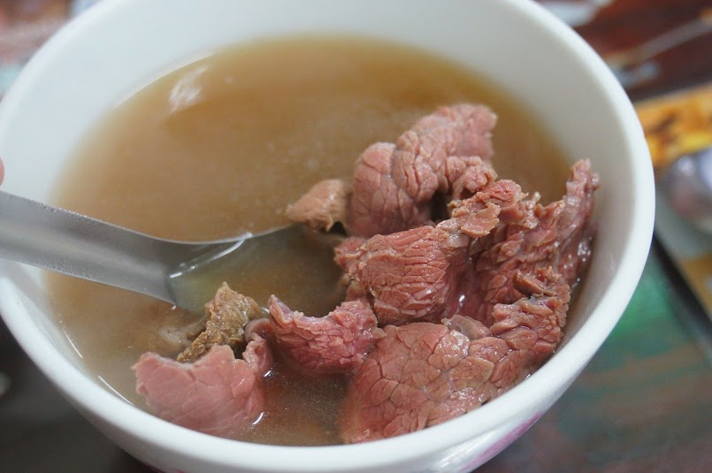
Chapter
Origin
Features
Historic site
Food

Slide 3
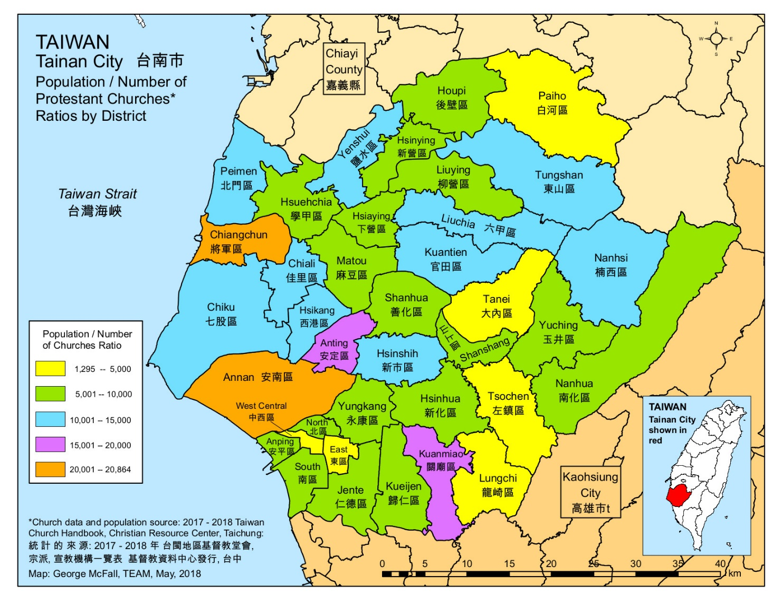
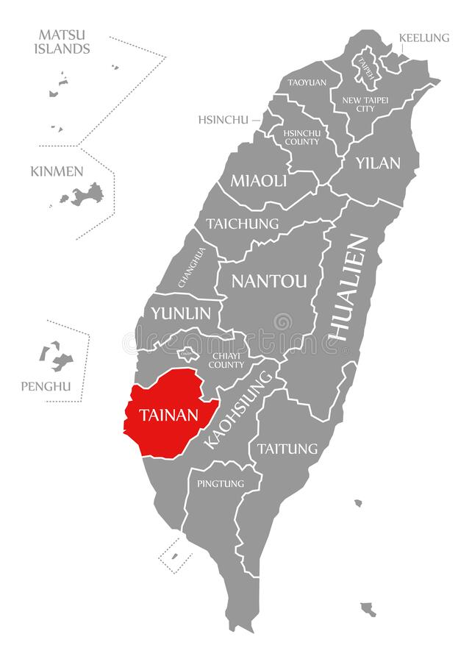
Tainan map

Slide 4
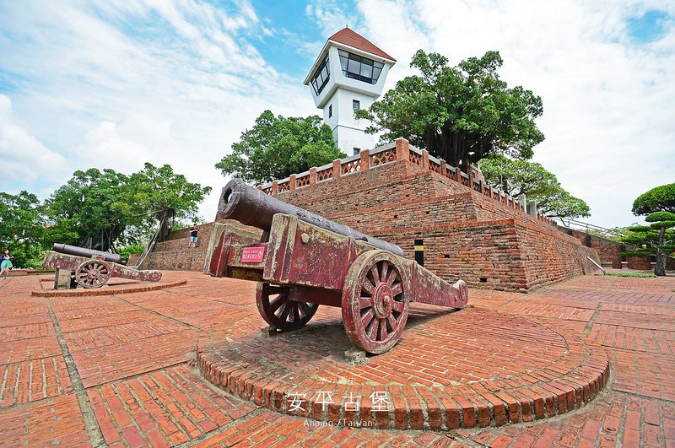
Fort Zeelandia (安平古堡/熱蘭遮城)
Anping Fort was built between 1624 and 1634. It was a fortress that once existed in Tainan, Taiwan. Originally built by the Dutch.

Slide 5
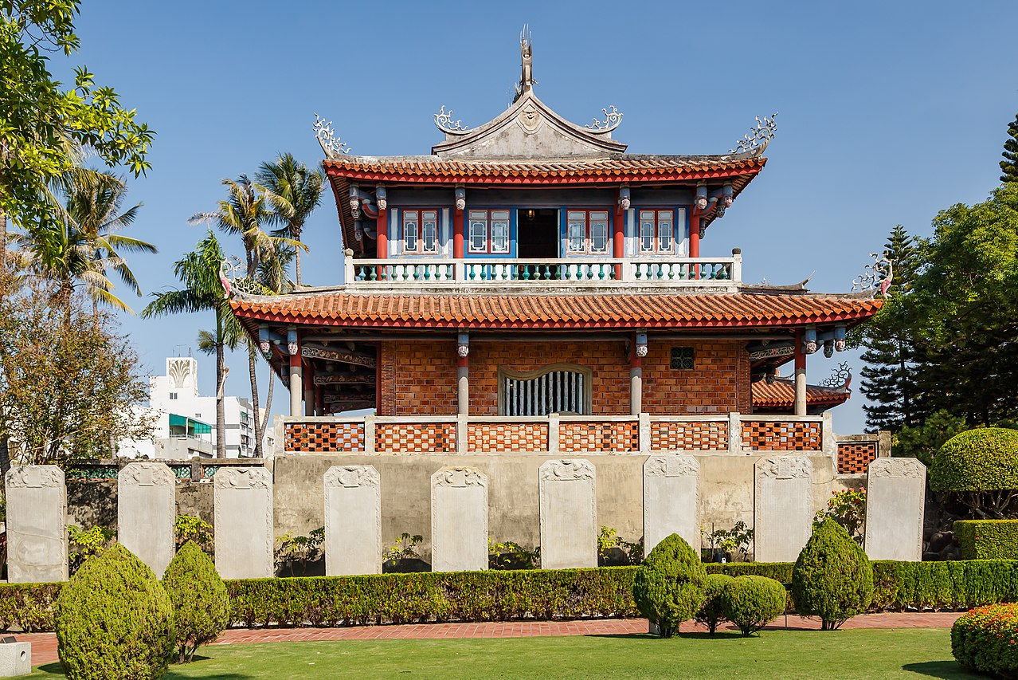
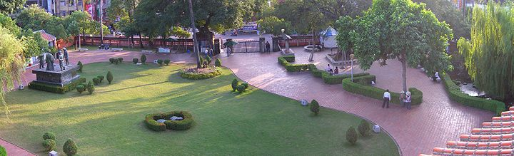
Fort Provintia (赤嵌樓/赤崁樓)
It used to be the commercial center of the entire Taiwan Island, and it has been dumped in the Qing Dynasty, leaving only some traces.
Overlooking the entrance from the Chihkan Tower; this is the air defense vacant area opened during World War II

Slide 6
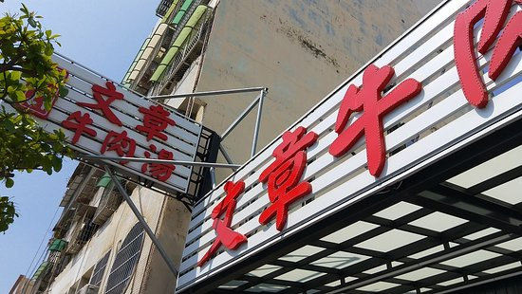
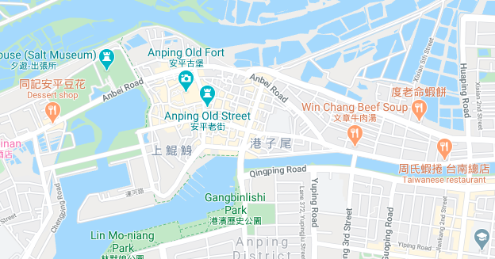
Win Chang Beef Soup
Popular snacks in Tainan. The special feature is the use of fresh warm beef slaughtered in the early morning of the day without freezing.

Slide 7
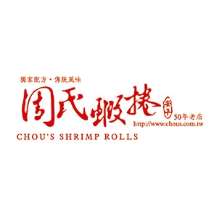
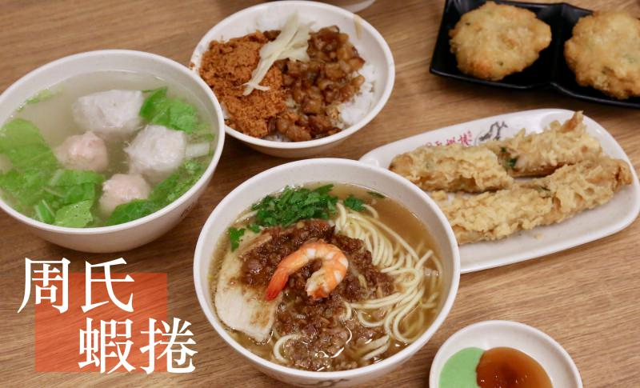
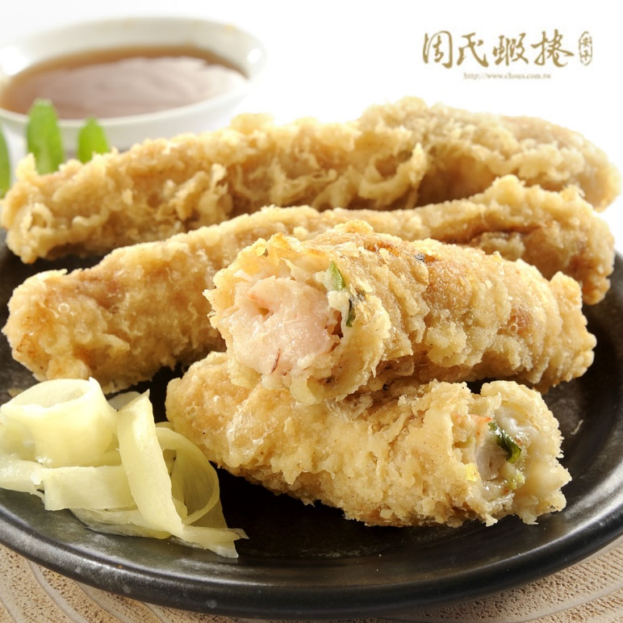
Chou's shrimp rolls
In the past, shrimp rolls were only one of the dishes in the snacks. By about 1980, the original shrimp rolls were improved. The shrimp rolls made mainly of fresh shrimp were deep, using their own name "Zhou" as the store number Called "Chou's shrimp rolls“.

Slide 8
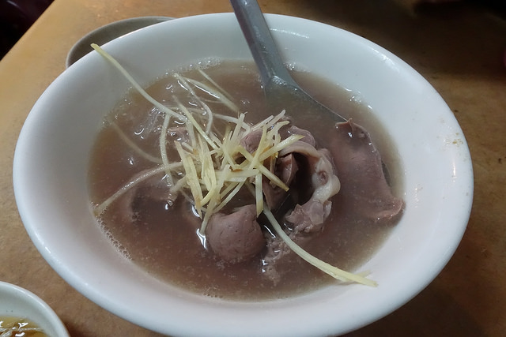
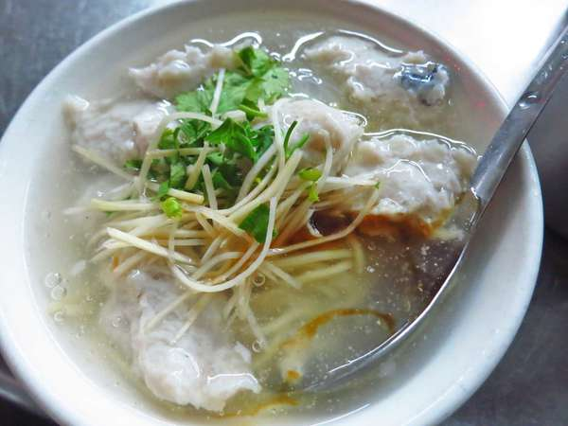
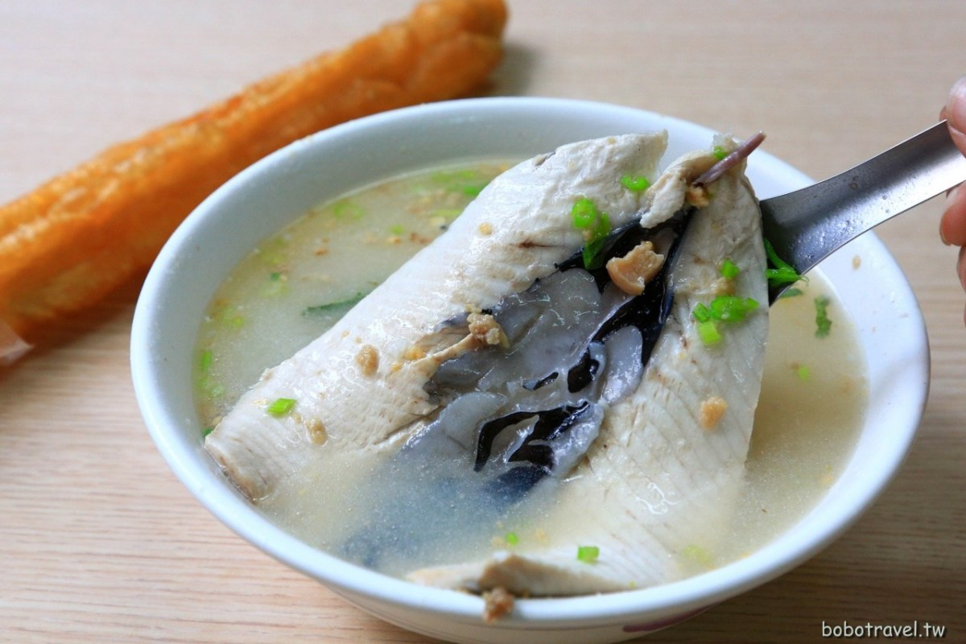
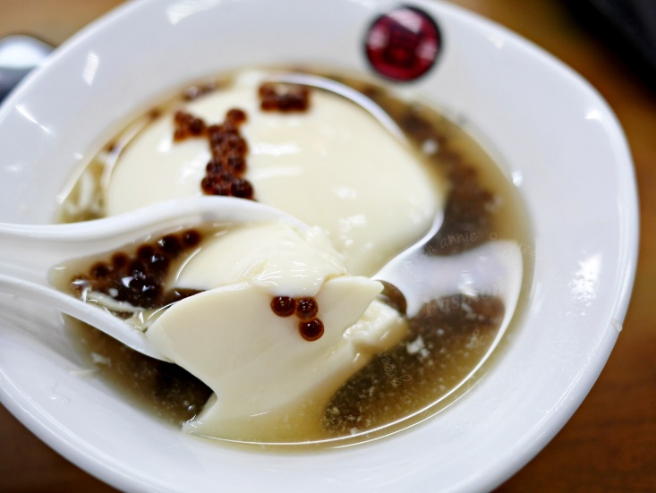
More More food

Slide 9
Reference
https://www.tmf.org.tw/~tmforg5/index.php?option=com_content&view=category&id=301&Itemid=839
https://zh.wikipedia.org/wiki/%E5%AE%89%E5%B9%B3%E5%8F%A4%E5%A0%A1
https://zh.wikipedia.org/wiki/%E8%B5%A4%E5%B4%81%E6%A8%93

Slide 10
Thanks

